Slide 1
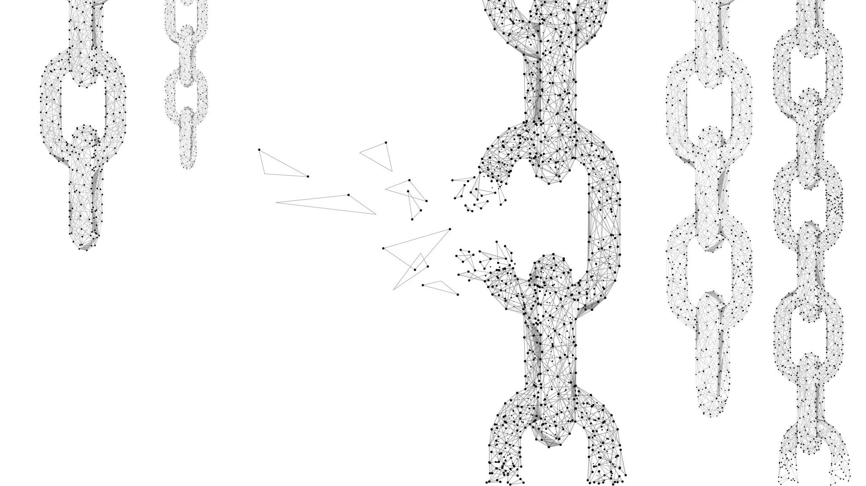
Breakdown of Superdiffusion in Perturbed Quantum Integrable Spin Chains and Ladders
Kevin Wang, Joel Moore
UC Berkeley
EPiQS Symposium 2025

Slide 2
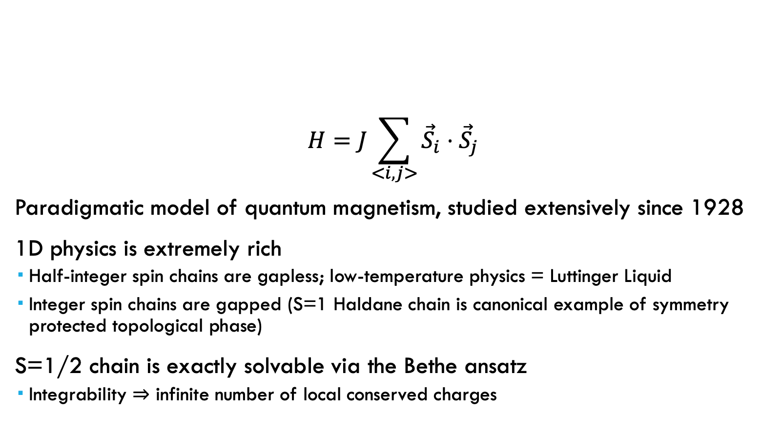
Quantum Heisenberg Model
$$H=J\sum_{<i,j>}{{\vec{S}}_{i}}⋅{\vec{S}}_{j}$$
Paradigmatic model of quantum magnetism, studied extensively since 1928
1D physics is extremely rich
Half-integer spin chains are gapless; low-temperature physics = Luttinger Liquid
Integer spin chains are gapped (S=1 Haldane chain is canonical example of symmetry protected topological phase)
S=1/2 chain is exactly solvable via the Bethe ansatz
Integrability $⇒$ infinite number of local conserved charges

Slide 3
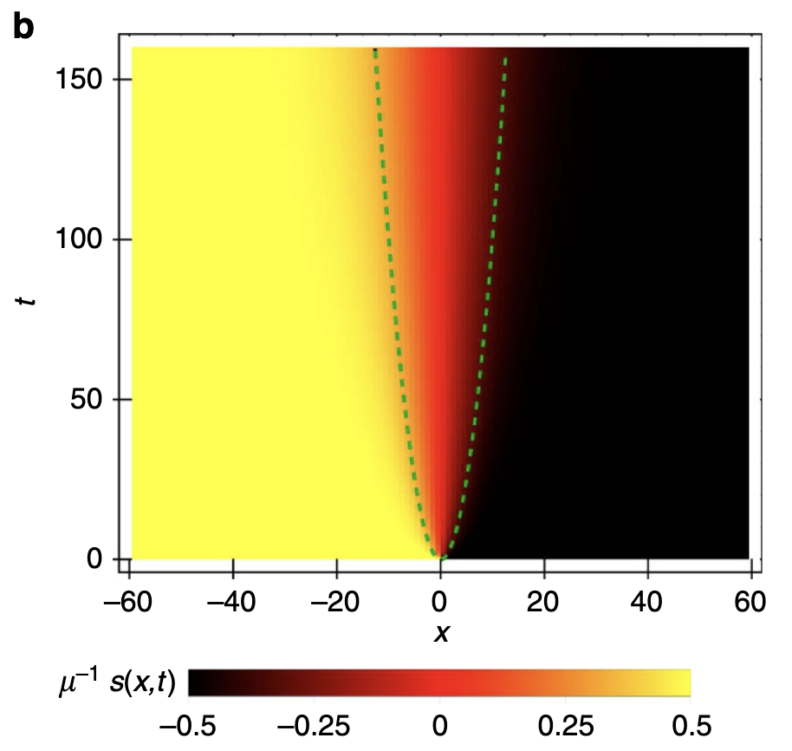
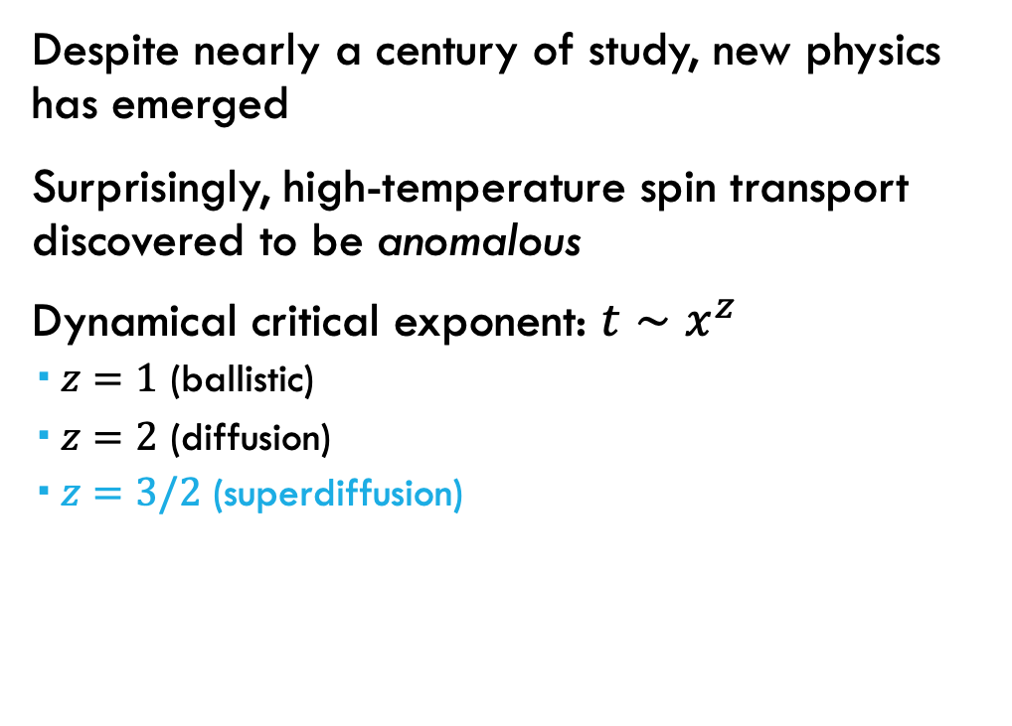

S=1/2 Heisenberg Chain: Anomalous Spin Transport
Despite nearly a century of study, new physics has emerged
Surprisingly, high-temperature spin transport discovered to be anomalous
Dynamical critical exponent: $t∼x^{z}$
$z=1$ (ballistic)
$z=2$ (diffusion)
$z=3/2$ (superdiffusion)
$$x \sim t^{2/3}$$
Ljubotina, Žnidarič & Prosen, ‘17

Slide 4
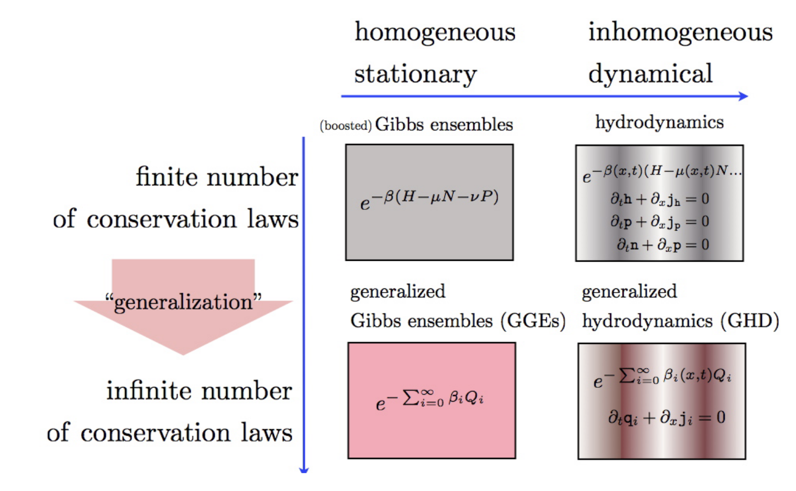
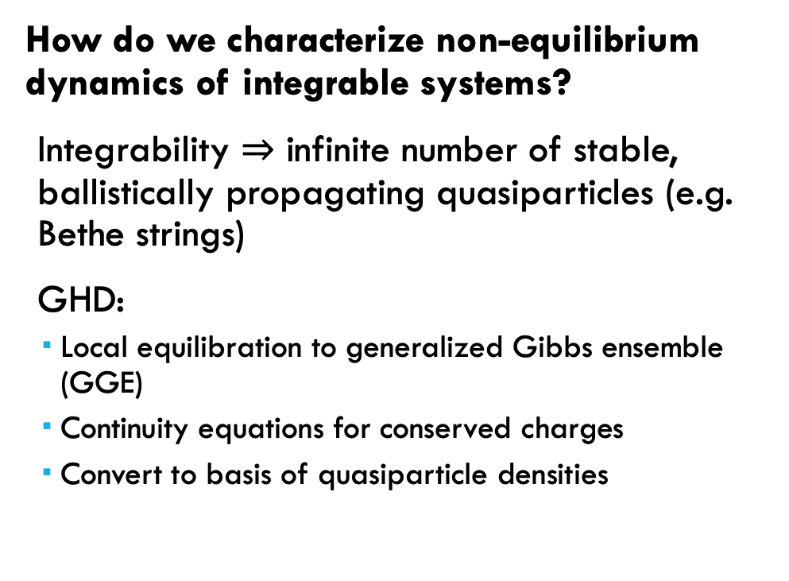
Generalized Hydrodynamics (GHD)
How do we characterize non-equilibrium dynamics of integrable systems?
Integrability $⇒$ infinite number of stable, ballistically propagating quasiparticles (e.g. Bethe strings)
GHD:
Local equilibration to generalized Gibbs ensemble (GGE)
Continuity equations for conserved charges
Convert to basis of quasiparticle densities
Doyon, SciPost Phys. Lect. Notes, ‘20
Notes:
Infinite conservation laws, failure to thermalize

Slide 5
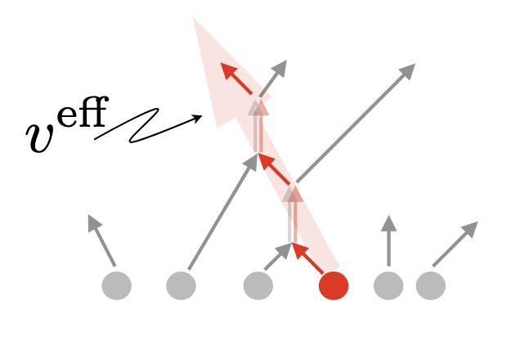
Generalized Hydrodynamics (GHD)
Intuitive picture: quasiparticles travel ballistically with effective velocity and charge dressed (renormalized) by elastic collisions with other quasiparticles
Doyon, SciPost Phys. Lect. Notes, ‘20
Notes:
Infinite conservation laws, failure to thermalize

Slide 6
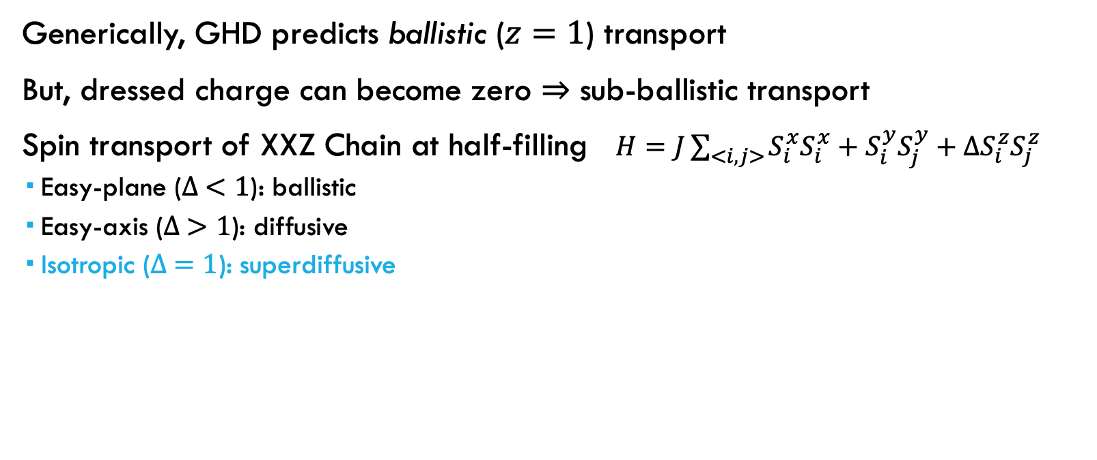
S=1/2 Heisenberg Chain: Anomalous Spin Transport
Generically, GHD predicts ballistic ($z=1$) transport
But, dressed charge can become zero $⇒$ sub-ballistic transport
Spin transport of XXZ Chain at half-filling $H=J\sum_{<i,j>}{S_{i}^{x}S_{i}^{x}+S_{i}^{y}S_{j}^{y}+ΔS_{i}^{z}S_{j}^{z}}$
Easy-plane ($∆ <1$): ballistic
Easy-axis ($∆ >1$): diffusive
Isotropic ($∆ =1$): superdiffusive

Slide 7
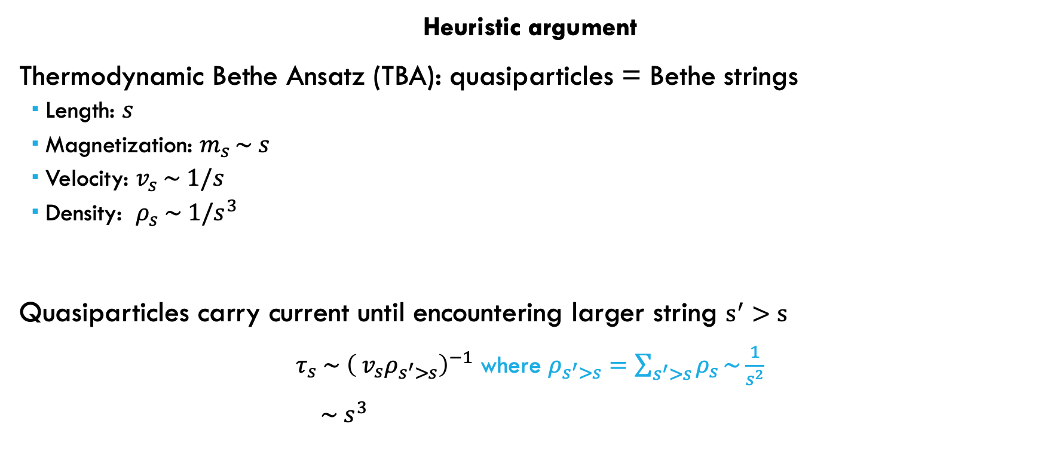
Why superdiffusion?
Heuristic argument
Thermodynamic Bethe Ansatz (TBA): quasiparticles = Bethe strings
Length: $s$
Magnetization: $m_{s }\sim s$
Velocity: $v_{s} \sim 1/s$
Density: $ρ_{s} \sim 1/s^{3}$
Quasiparticles carry current until encountering larger string $s^{′}>s$
$τ_{s} \sim {\left({ v}_{s}ρ_{s^{′}>s}\right)}^{−1}$ where $ρ_{s^{′}>s}=\sum_{s^{′}>s}{ρ_{s}}\sim \frac{1}{s^{2}}$
$\sim s^{3}$

Slide 8
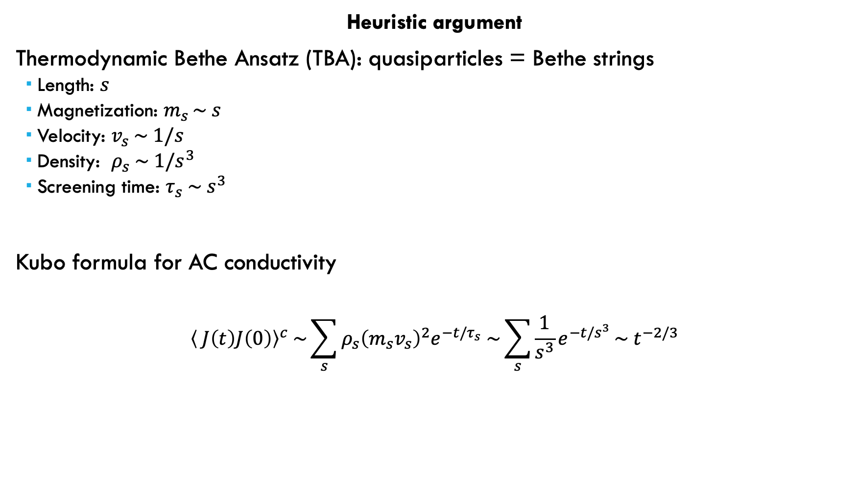
Why superdiffusion?
Heuristic argument
Thermodynamic Bethe Ansatz (TBA): quasiparticles = Bethe strings
Length: $s$
Magnetization: $m_{s }\sim s$
Velocity: $v_{s} \sim 1/s$
Density: $ρ_{s} \sim 1/s^{3}$
Screening time: $τ_{s} \sim s^{3}$
Kubo formula for AC conductivity
$${\left\langle J\left(t\right)J\left(0\right)\right\rangle }^{c} \sim \sum_{s}{ρ_{s}{\left(m_{s}v_{s}\right)}^{2}e^{−t/τ_{s}} \sim \sum_{s}{\frac{1}{s^{3}}e^{−t/s^{3}}}\sim { t}^{−2/3}}$$

Slide 9
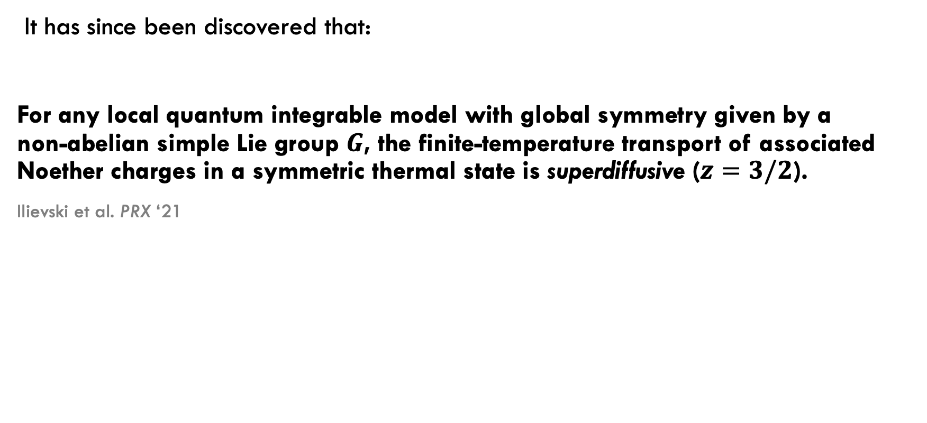
“Superuniversality” of superdiffusion
It has since been discovered that:
For any local quantum integrable model with global symmetry given by a non-abelian simple Lie group $G$, the finite-temperature transport of associated Noether charges in a symmetric thermal state is superdiffusive ($z=3/2$).
Ilievski et al. PRX ‘21

Slide 10
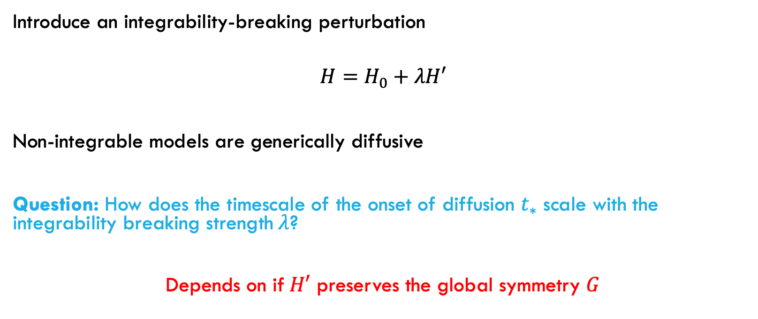
Breaking integrability
Introduce an integrability-breaking perturbation
$$H=H_{0}+λH′$$
Non-integrable models are generically diffusive
Question: How does the timescale of the onset of diffusion $t_{∗}$ scale with the integrability breaking strength$λ$?
Depends on if$H′$ preserves the global symmetry $G$

Slide 11
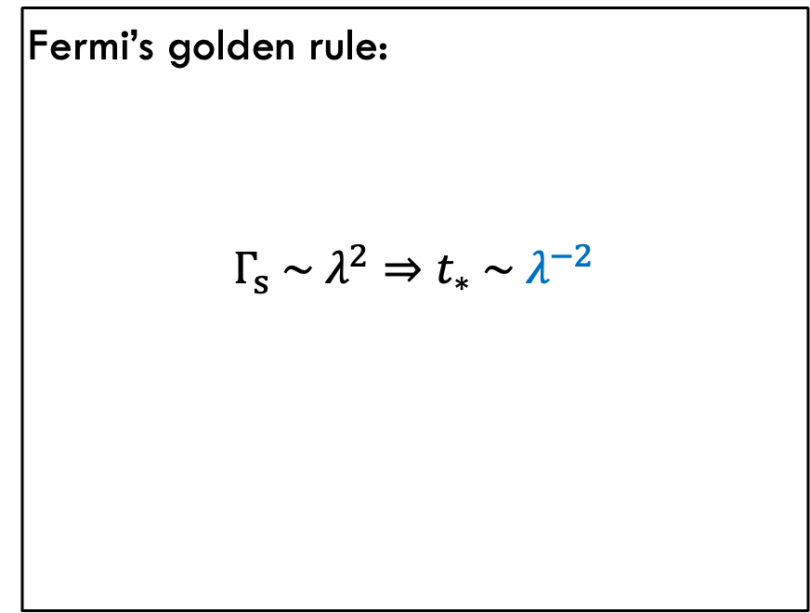
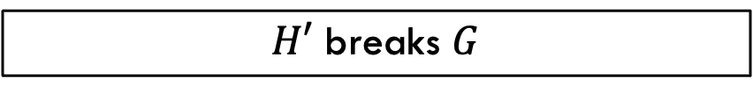
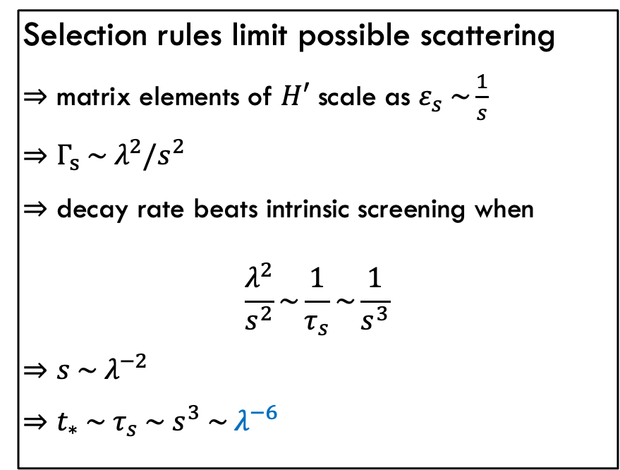
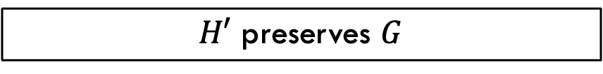
Breaking integrability
$H′$ breaks $G$
$H′$ preserves $G$
Fermi’s golden rule:
$$Γ_{s} \sim λ^{2}⇒t_{∗} \sim λ^{−2}$$
Selection rules limit possible scattering
$⇒$ matrix elements of $H′$ scale as $ε_{s} \sim \frac{1}{s}$
$⇒$ $Γ_{s} \sim λ^{2}/s^{2}$
$⇒$ decay rate beats intrinsic screening when
$$\frac{λ^{2}}{s^{2}}\sim \frac{1}{τ_{s}}\sim \frac{1}{s^{3}}$$
$⇒$ $s \sim λ^{−2}$
$⇒$ $t_{∗} \sim τ_{s} \sim s^{3} \sim λ^{−6}$

Slide 12
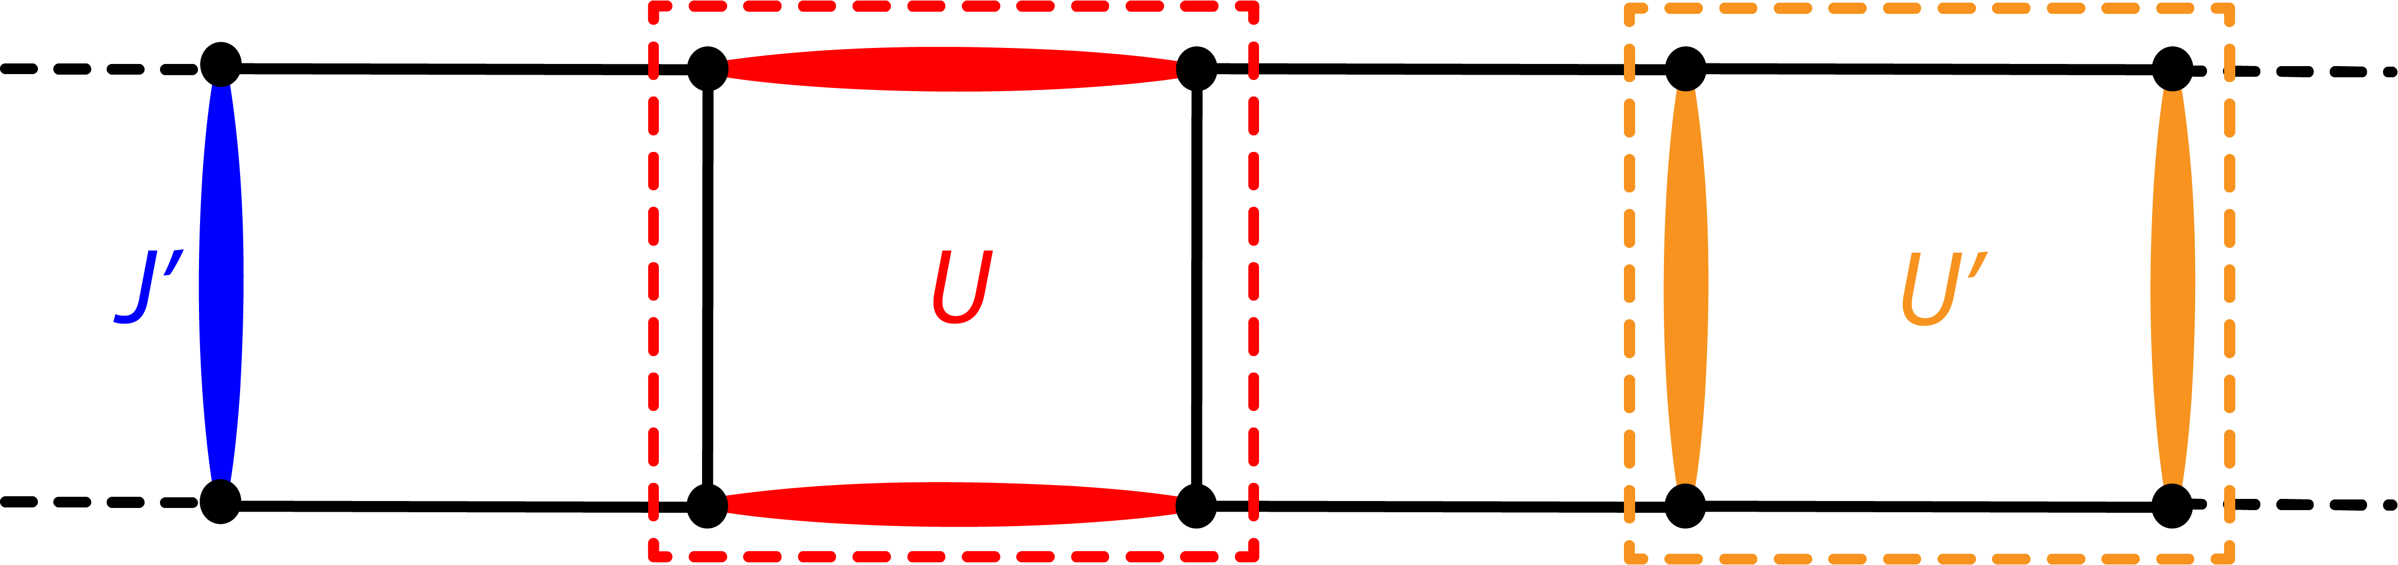
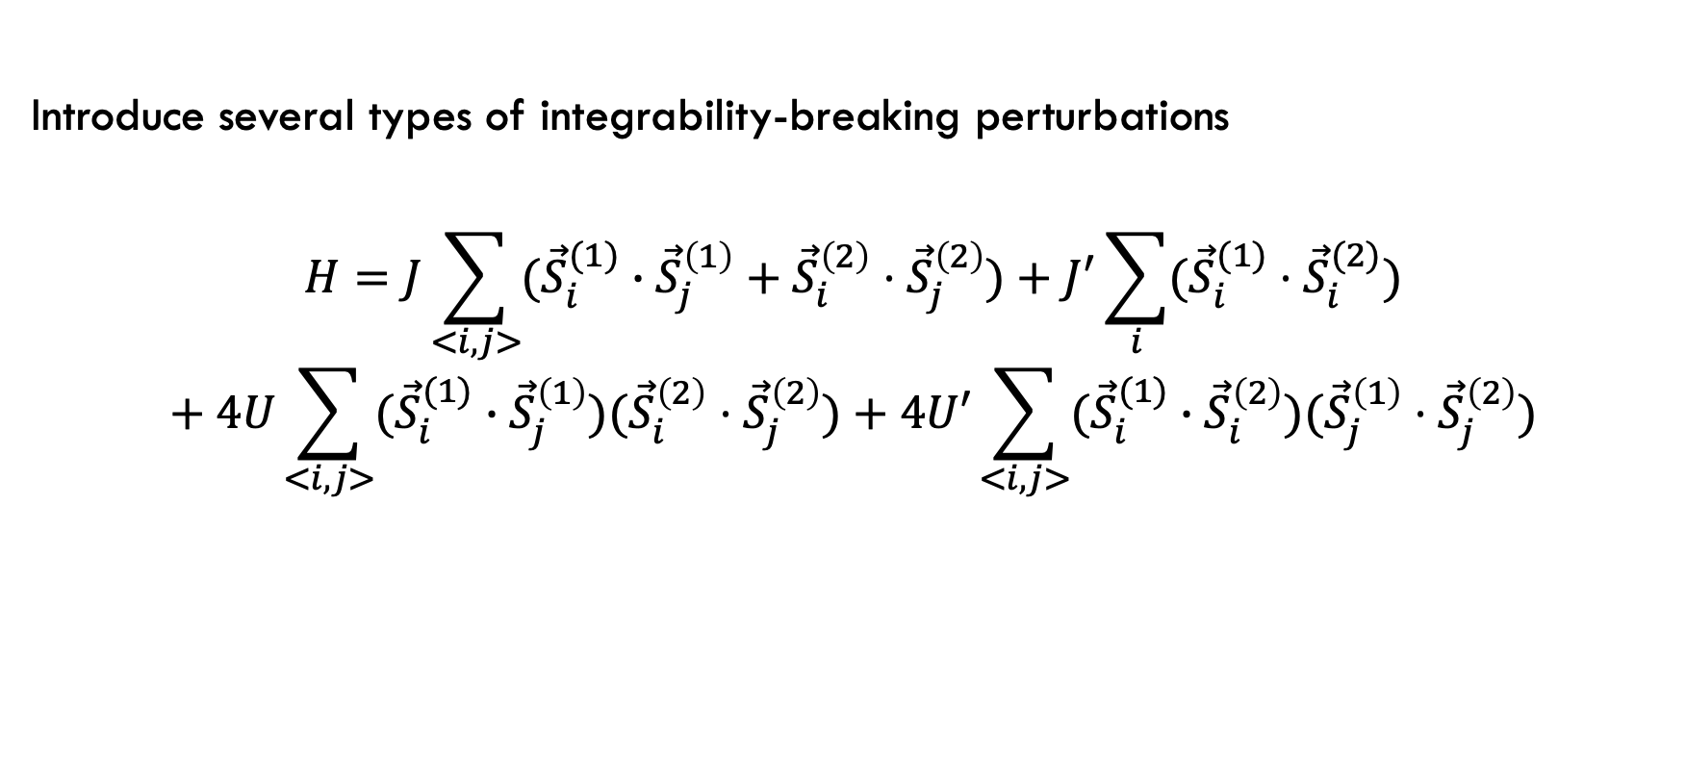
Heisenberg ladder
Introduce several types of integrability-breaking perturbations
$$H=J\sum_{<i,j>}{({\vec{S}}_{i}^{(1)}}∙{\vec{S}}_{j}^{\left(1\right)}+{\vec{S}}_{i}^{\left(2\right)}⋅{\vec{S}}_{j}^{\left(2\right)})+J^{′}\sum_{i}{({\vec{S}}_{i}^{(1)}⋅{\vec{S}}_{i}^{(2)})}$$
$$+ 4U\sum_{<i,j>}{({\vec{S}}_{i}^{(1)}}∙{\vec{S}}_{j}^{\left(1\right)})({\vec{S}}_{i}^{\left(2\right)}⋅{\vec{S}}_{j}^{\left(2\right)})+4U′\sum_{<i,j>}{({\vec{S}}_{i}^{(1)}}∙{\vec{S}}_{i}^{\left(2\right)})({\vec{S}}_{j}^{\left(1\right)}⋅{\vec{S}}_{j}^{\left(2\right)})$$

Slide 13

Heisenberg ladder
Consider two integrable points to perturb around:
$J^{′}=U=U^{′}=0$
$$H_{0}=J\sum_{<i,j>}{({\vec{S}}_{i}^{(1)}}∙{\vec{S}}_{j}^{\left(1\right)}+{\vec{S}}_{i}^{\left(2\right)}⋅{\vec{S}}_{j}^{\left(2\right)})$$
$$G=SU\left(2\right) × SU(2)$$

Slide 14
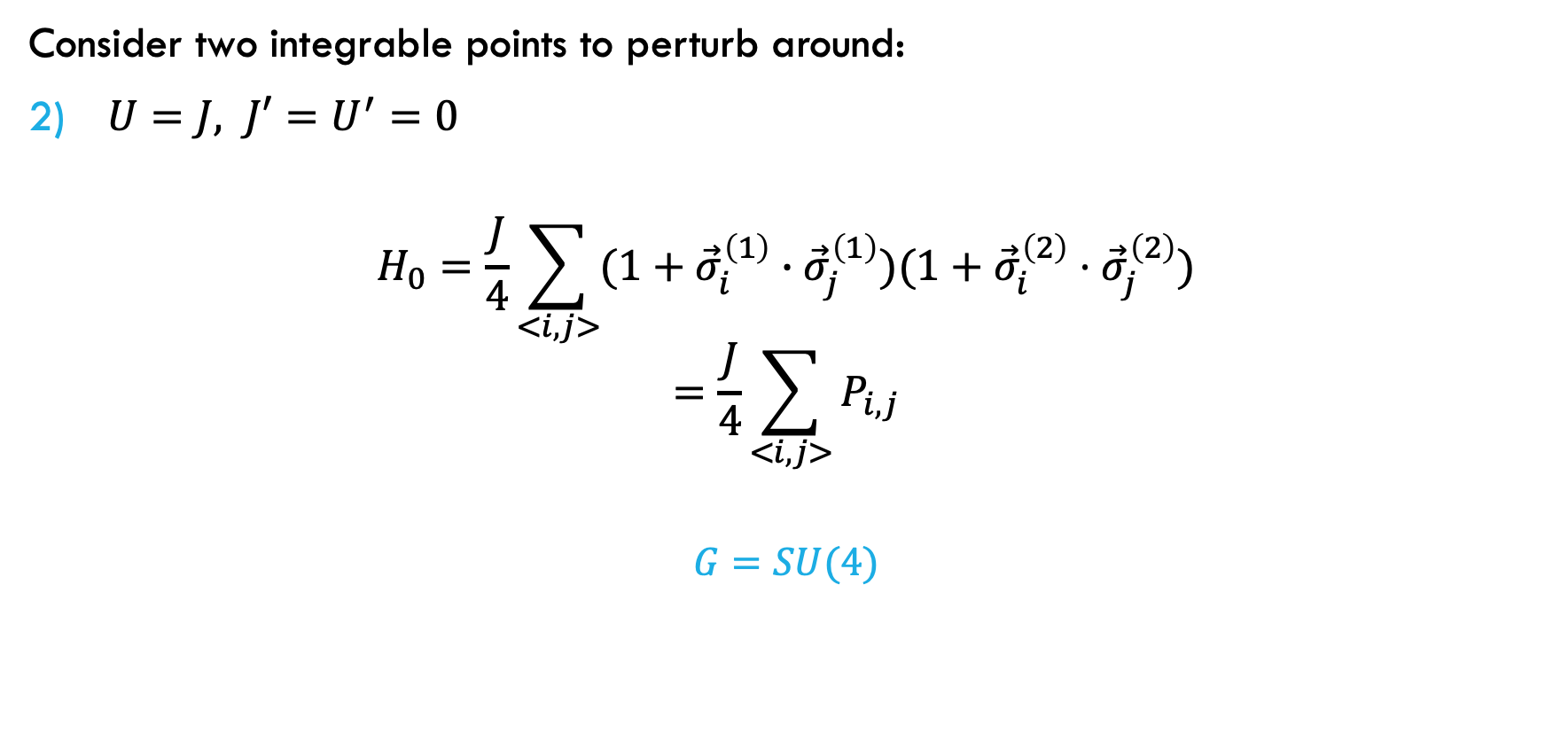
Heisenberg ladder
Consider two integrable points to perturb around:
$U=J, J′=U^{′}=0$
$$H_{0}=\frac{J}{4}\sum_{<i,j>}{(1+{\vec{σ}}_{i}^{\left(1\right)}}∙{\vec{σ}}_{j}^{\left(1\right)})(1+{\vec{σ}}_{i}^{\left(2\right)}⋅{\vec{σ}}_{j}^{\left(2\right)})$$
$$=\frac{J}{4}\sum_{<i,j>}{P_{i,j}}$$
$$G=SU(4)$$

Slide 15
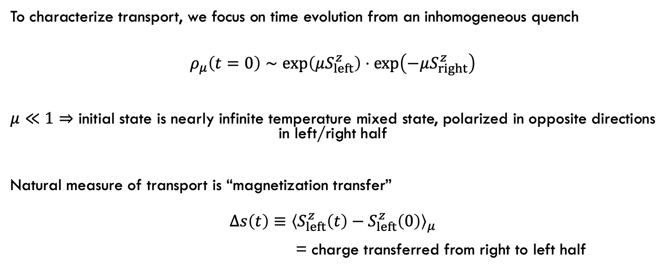
Spin Transport
To characterize transport, we focus on time evolution from an inhomogeneous quench
$$ρ_{μ}\left(t=0\right)∼\exp\left(μS_{left}^{z}\right)⋅\exp\left(−μS_{right}^{z}\right)$$
$μ≪1⇒$ initial state is nearly infinite temperature mixed state, polarized in opposite directions in left/right half
Natural measure of transport is “magnetization transfer”
$$Δs\left(t\right)≡{\left\langle S_{left}^{z}\left(t\right)−S_{left}^{z}\left(0\right)\right\rangle }_{μ}$$
= charge transferred from right to left half

Slide 16
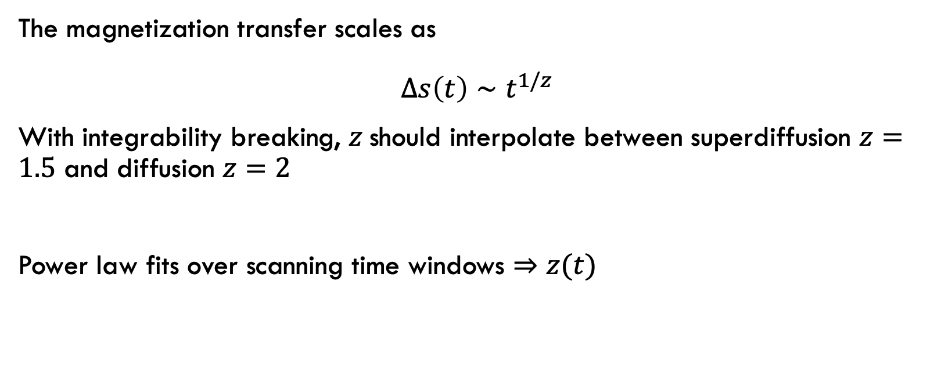
Spin Transport
The magnetization transfer scales as
$$Δs\left(t\right)∼t^{1/z}$$
With integrability breaking, $z$should interpolate between superdiffusion $z=1.5$ and diffusion $z=2$
Power law fits over scanning time windows $⇒$ $z(t)$

Slide 17


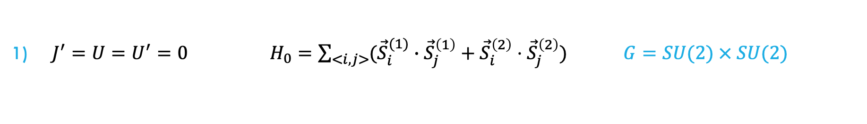

Spin Transport
$J^{′}=U=U^{′}=0 H_{0}=\sum_{<i,j>}{({\vec{S}}_{i}^{(1)}}∙{\vec{S}}_{j}^{\left(1\right)}+{\vec{S}}_{i}^{\left(2\right)}⋅{\vec{S}}_{j}^{\left(2\right)}) G=SU(2) × SU(2)$
$G$-breaking
$G$-breaking
$G$-invariant

Slide 18
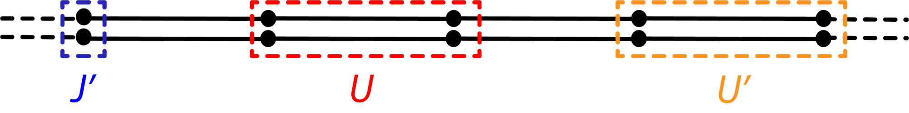
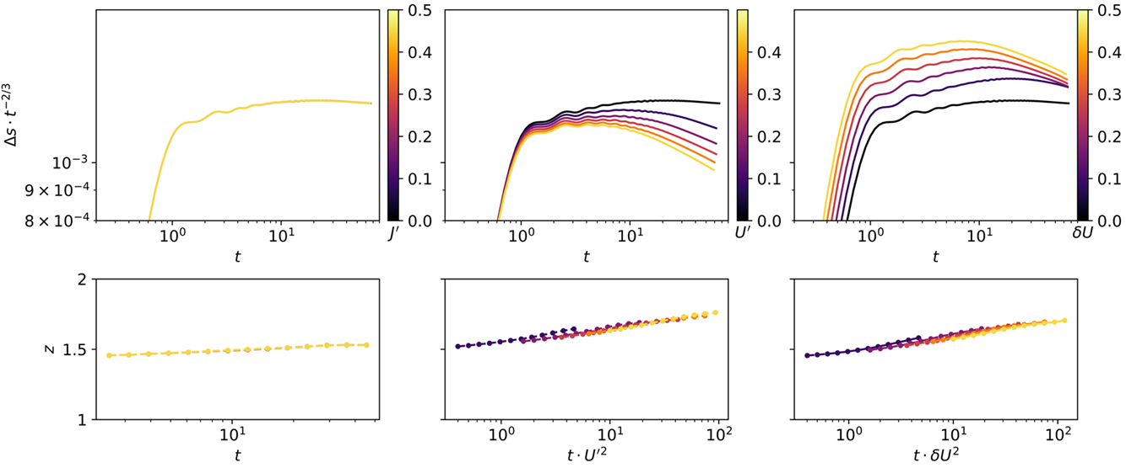


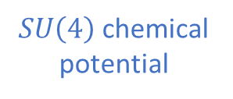
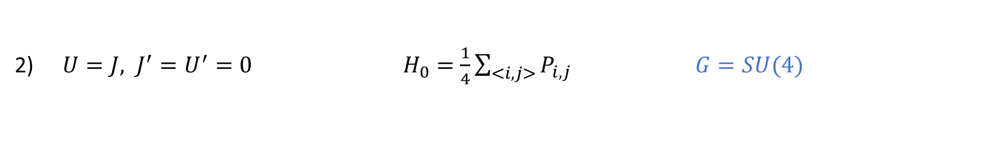
Spin Transport
$U=J, J^{′}=U^{′}=0 { H}_{0}=\frac{1}{4}\sum_{<i,j>}{P_{i,j}}$ $G=SU(4)$
$SU\left(4\right)$chemical potential
$G$-breaking
$G$-breaking

Slide 19
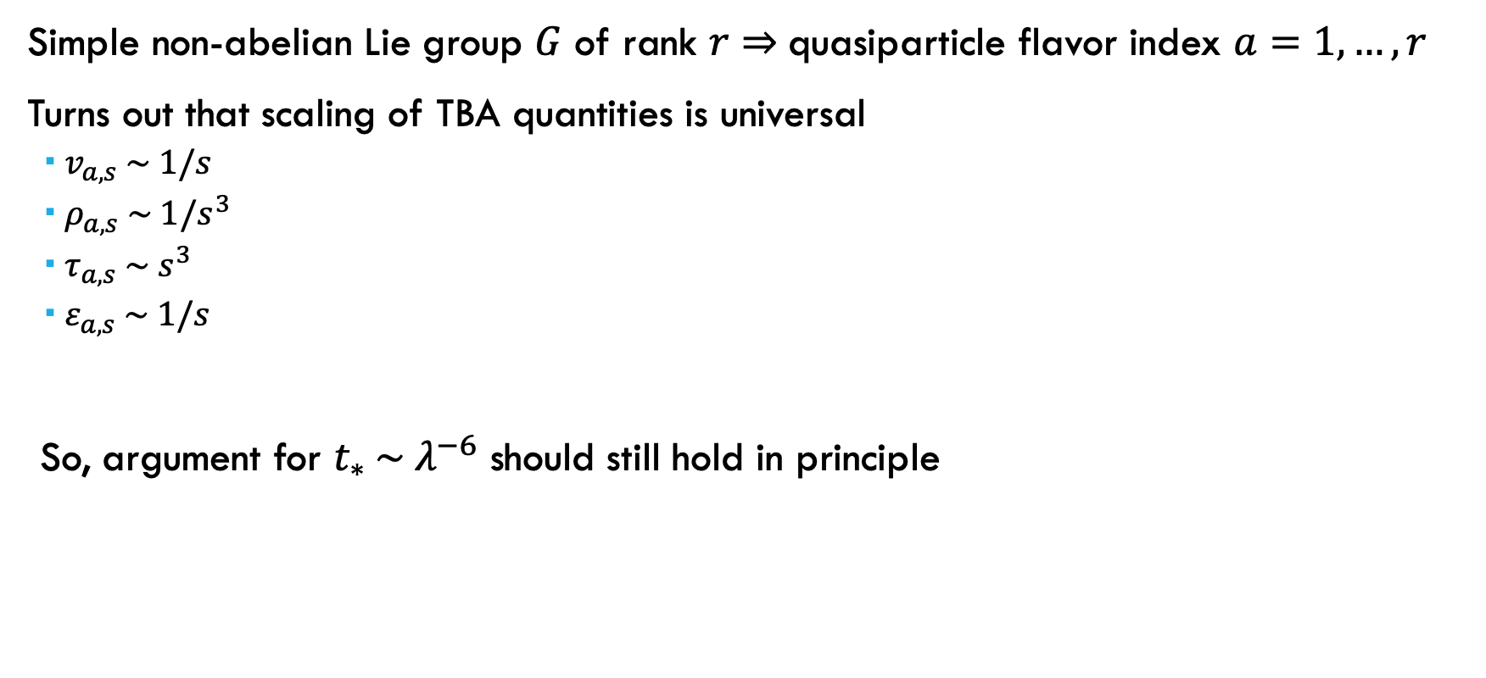
Superuniversal 𝐺-invariant behavior?
Simple non-abelian Lie group $G$ of rank $r⇒$quasiparticle flavor index $a=1,…,r$
Turns out that scaling of TBA quantities is universal
$v_{a,s} \sim 1/s$
$ρ_{a,s} \sim 1/s^{3}$
$τ_{a,s} \sim s^{3}$
$ε_{a,s} \sim 1/s$
So, argument for $t_{∗} \sim λ^{−6}$ should still hold in principle

Slide 20
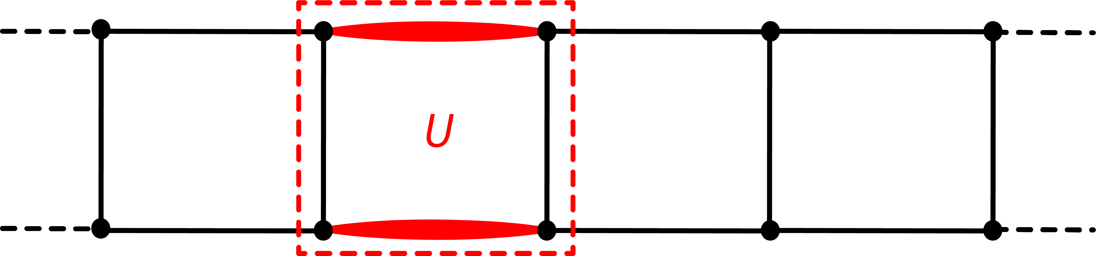
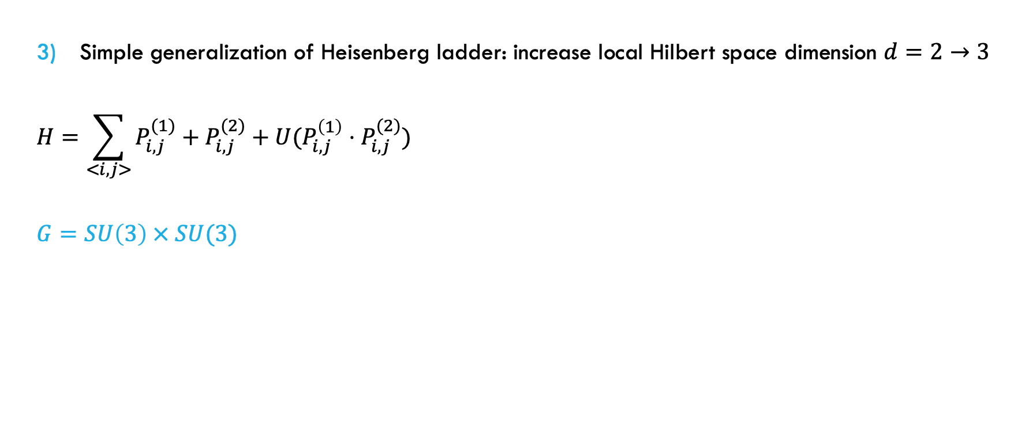
Spin Transport
Simple generalization of Heisenberg ladder: increase local Hilbert space dimension $d=2→3$
$$H=\sum_{<i,j>}{P_{i,j}^{(1)}+P_{i,j}^{(2)}+U(P_{i,j}^{\left(1\right)}⋅P_{i,j}^{(2)})}$$
$$G=SU\left(3\right) × SU(3)$$

Slide 21
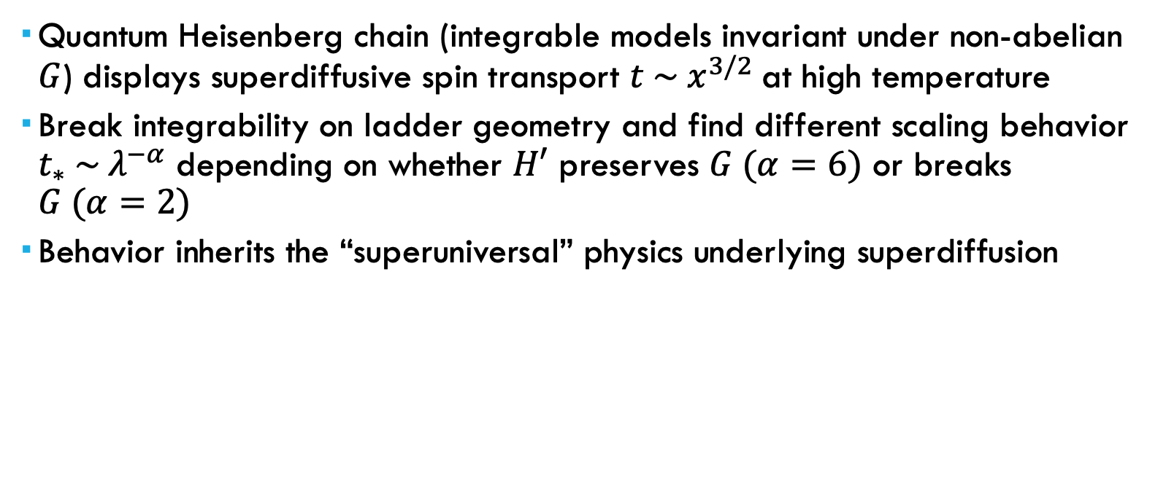
Summary
Quantum Heisenberg chain (integrable models invariant under non-abelian $G$) displays superdiffusive spin transport $t \sim x^{3/2}$at high temperature
Break integrability on ladder geometry and find different scaling behavior $t_{∗} \sim λ^{−α}$ depending on whether $H′$ preserves $G (α=6)$ or breaks $G (α=2)$
Behavior inherits the “superuniversal” physics underlying superdiffusion

Slide 22



Thanks!
Joel Moore

